Slide 1
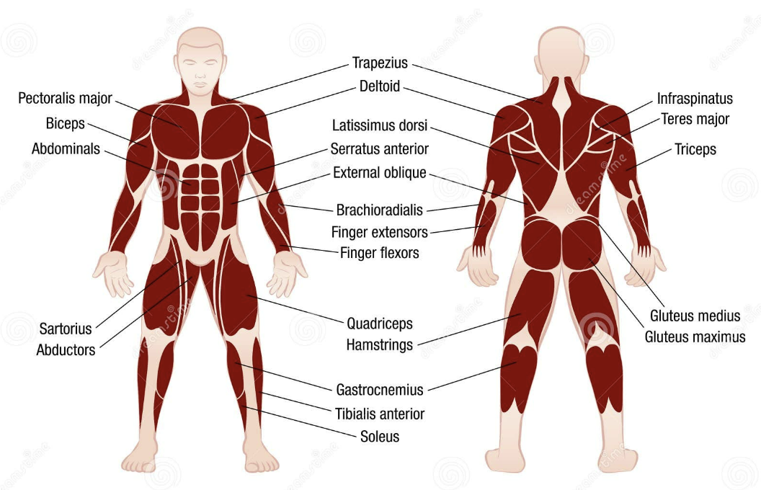

Home
Filter
Muscle
Tag
Bench
Bench
Bench
Kg
Kg
Kg
Reps
Reps
Reps
ㅁ log as a warming up set
ㅁ log as a warming up set
ㅁ log as a warming up set
LOG
LOG
LOG
Home
Status
Setting

Slide 2
Home
Filter
Muscle
Tag
Bench
# push # Monday
Personal Record
100 kg
:27 – 02 - 2001
(4 days ago)
Last exercise : 27 – 02 - 2001
Main : chest
Sub : forearm
Bench
# push # Monday
Personal Record
100 kg
:27 – 02 - 2001
(4 days ago)
Last exercise : 27 – 02 - 2001
Main : chest
Sub : forearm
Home
Status
Setting

Slide 3
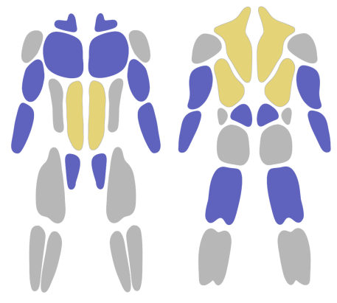
Home
Filter
Muscle
Tag
Bench
# push # Monday
Personal Record
100 kg
:27 – 02 - 2001
(4 days ago)
Last exercise : 27 – 02 - 2001
Main : chest
Sub : forearm
Bench
# push # Monday
Personal Record
100 kg
:27 – 02 - 2001
(4 days ago)
Last exercise : 27 – 02 - 2001
Main : chest
Sub : forearm
Home
Status
Setting

Slide 4
`
< Bench
5
MAX Kg
Mean Reps
MAX
Set 2 | 12 kg * 5
12
15
4
28-02-2024 (4 days ago)
Kg
Reps
Sets
24-02-2024 ~ 28-02-2024
28-02-2024 (4 days ago)
Set 1 | 10 kg * 5
Set 2 | 10 kg * 5
Set 3 | 10 kg * 5
TODAY
Set 1 | 10 kg * 5
Set 2 | 10 kg * 5
Set 3 | 10 kg * 5
MEAN
Kg
Reps
Sets
28-02-2024 (4 days ago)
Set 1 | 10 kg * 5
Set 2 | 10 kg * 5
Set 3 | 10 kg * 5
28-02-2024 (4 days ago)
Set 1 | 10 kg * 5
Set 2 | 10 kg * 5
Set 3 | 10 kg * 5
28-02-2024 (4 days ago)
Set 1 | 10 kg * 5
Set 2 | 10 kg * 5
Set 3 | 10 kg * 5
28-02-2024 (4 days ago)
Set 1 | 10 kg * 5
Set 2 | 10 kg * 5
Set 3 | 10 kg * 5
28-02-2024 (4 days ago)
Set 1 | 10 kg * 5
Set 2 | 10 kg * 5
Set 3 | 10 kg * 5
28-02-2024 (4 days ago)
Set 1 | 10 kg * 5
Set 2 | 10 kg * 5
Set 3 | 10 kg * 5
Kg
ㅁ log as a warming up set
Reps
LOG

Slide 5
Status
Filter
Muscle
Tag
ADD NEW EXERCISE
Bench
# push # Monday
Personal Record
100 kg
:27 – 02 - 2001
(4 days ago)
Last exercise : 27 – 02 - 2001
Main : chest
Sub : forearm
Bench
# push # Monday
Personal Record
100 kg
:27 – 02 - 2001
(4 days ago)
Last exercise : 27 – 02 - 2001
Main : chest
Sub : forearm
Bench
# push # Monday
Personal Record
100 kg
:27 – 02 - 2001
(4 days ago)
Last exercise : 27 – 02 - 2001
Main : chest
Sub : forearm
Bench
# push # Monday
Personal Record
100 kg
:27 – 02 - 2001
(4 days ago)
Last exercise : 27 – 02 - 2001
Main : chest
Sub : forearm
Bench
# push # Monday
Personal Record
100 kg
:27 – 02 - 2001
(4 days ago)
Last exercise : 27 – 02 - 2001
Main : chest
Sub : forearm
Home
Status
Setting

Slide 6
Home
Personal Information
App Version
Send Feedback
Privacy Policy
Home
Status
Setting

Slide 7
< Personal Information
Remove all the log data
Home
Status
Setting

Slide 8
< App Version
Current App version : 1.0.0
Home
Status
Setting

Slide 9
< Send Feedback
Home
Status
Setting

Slide 10
< Privacy Policy
Home
Status
Setting

